Slide 1
Smart Traffic Management System that is Cloud Based
"
Y.L.B.SNEHITH
192210274
K.V.RAJESH
192211900

Slide 2
ABSTRACT:
In the modern world, urban traffic congestion has become a significant challenge, leading to wasted time, increased fuel consumption, and environmental pollution. To address these issues, a smart traffic management system based on cloud computing has emerged as a promising solution. This system leverages the power of the cloud to collect, process, and analyze real-time traffic data from various sources.

Slide 3
INTRODUCTION:
Urbanization and population growth have led to an unprecedented increase in traffic congestion in cities worldwide.
This congestion not only causes frustration for commuters but also has a significant impact on the economy, environment
Overall quality of life need for innovative solutions that can optimize traffic flow, reduce congestion, and improve transportation efficiency.

Slide 4
OBJECTIVES:
To understand the challenges associated with urban traffic congestion and its impact on cities.
To introduce the concept of a smart traffic management system based on cloud computing technology.
To explore the key components and architecture of a cloud-based smart traffic management system.
To examine the role of data collection, processing, and analysis in optimizing traffic management decisions.

Slide 5
EXISTING SYSTEM
Traffic management has been a long-standing challenge in urban areas, with cities around the world .
Traditional traffic management systems rely on fixed-time traffic signal control
static traffic management strategies, which often result in suboptimal traffic flow
Increased congestion, especially during peak hours.

Slide 6
ADVANTAGES:
Reduced Congestion
Improved Safety
Environmental Benefits
Enhanced Efficiency
Data driven decision making
Enhanced User Experience
Adaptability to changing conditions

Slide 7
DISADVANTAGES:
High Initial Investment
Complexity
Data privacy
Security concerns
Dependency on Technology
Digital Divide
Potential for Overreliance
Maintenance and Upkeep

Slide 8
FUNCTIONAL REQUIREMENTS
Real-time Traffic Monitoring:The system should be able to collect and analyze real-time traffic data from various sources
Traffic Prediction and Forecasting: The system should be able to predict future traffic conditions based on historical data.
Dynamic Traffic Routing: The system should be able to dynamically reroute traffic in real time to avoid congestion.
Traffic Signal Optimization: The system should be able to optimize traffic signal timings based on real-time traffic conditions
.Emergency Response Management: The system should support emergency response management by providing real-time traffic information

Slide 9
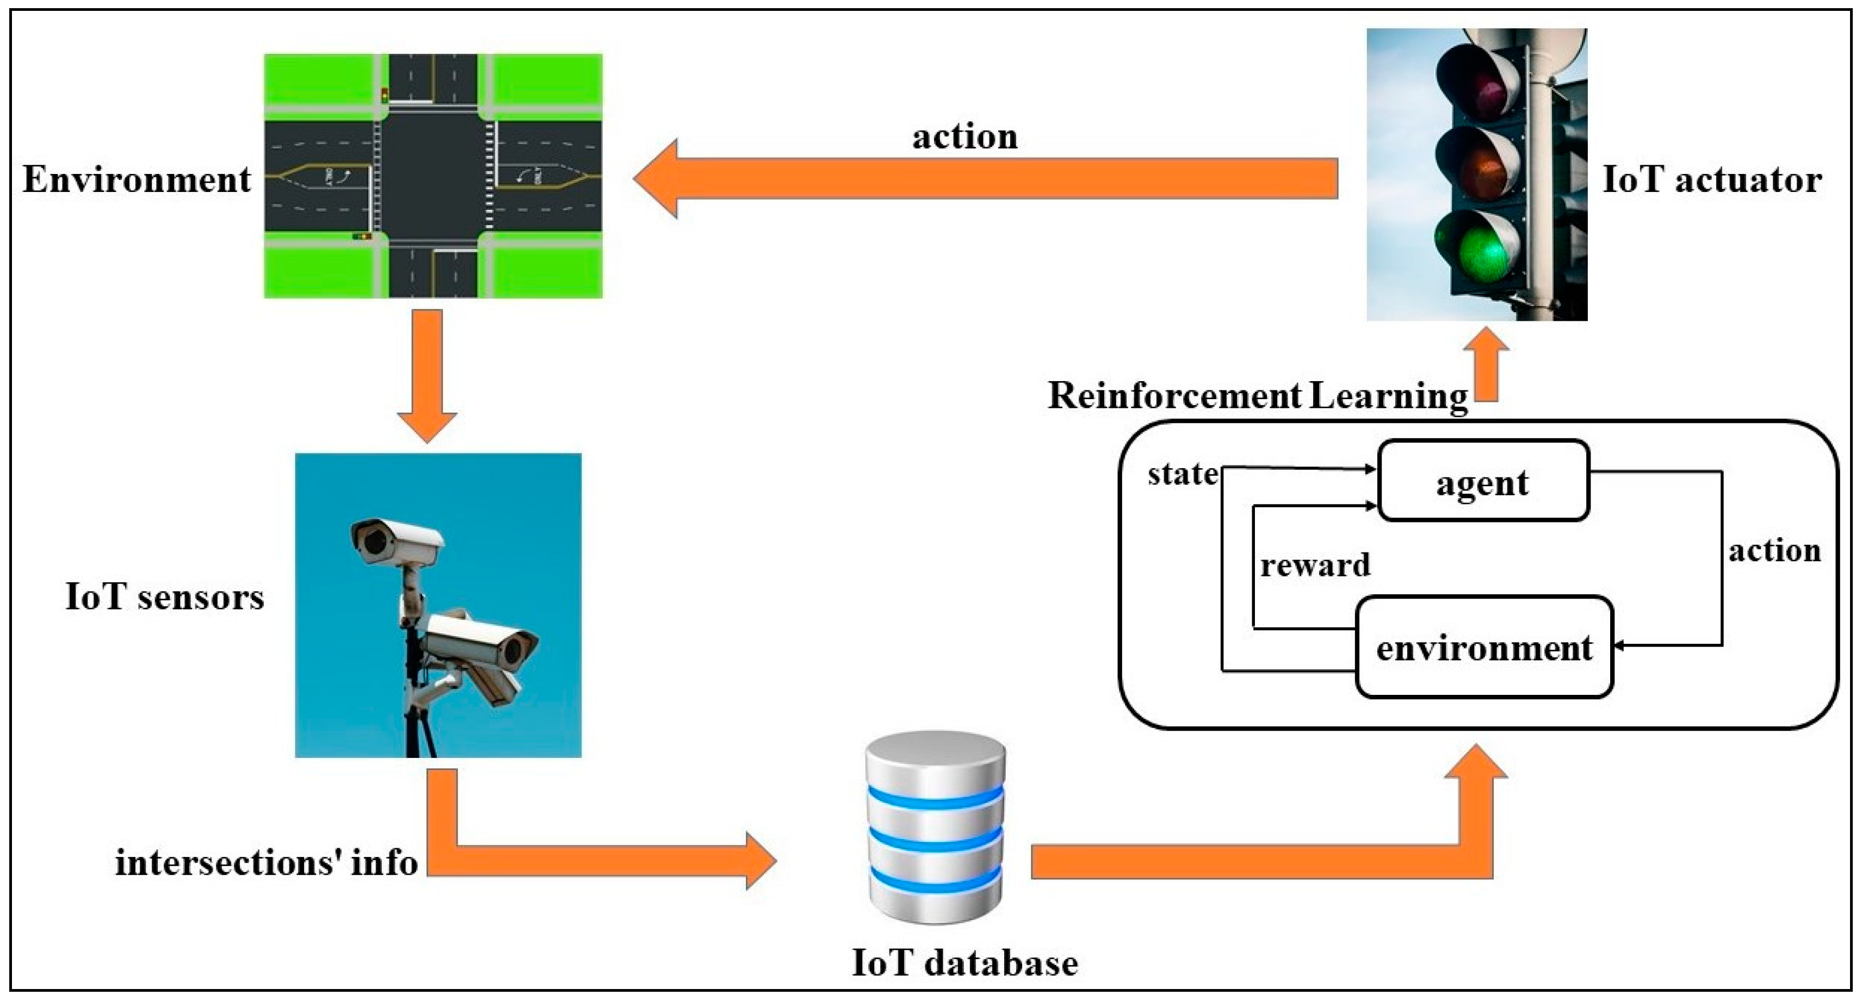
ARCHITECTURE DIAGRAM

Slide 10
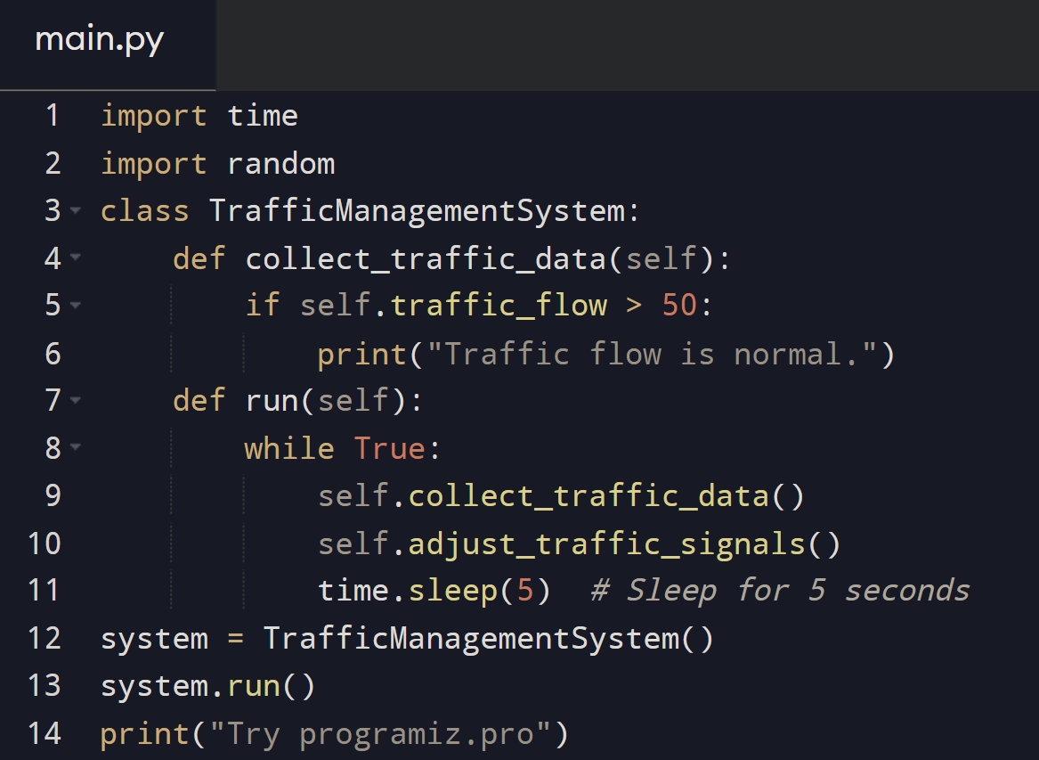
IMPLEMENTATION:

Slide 11
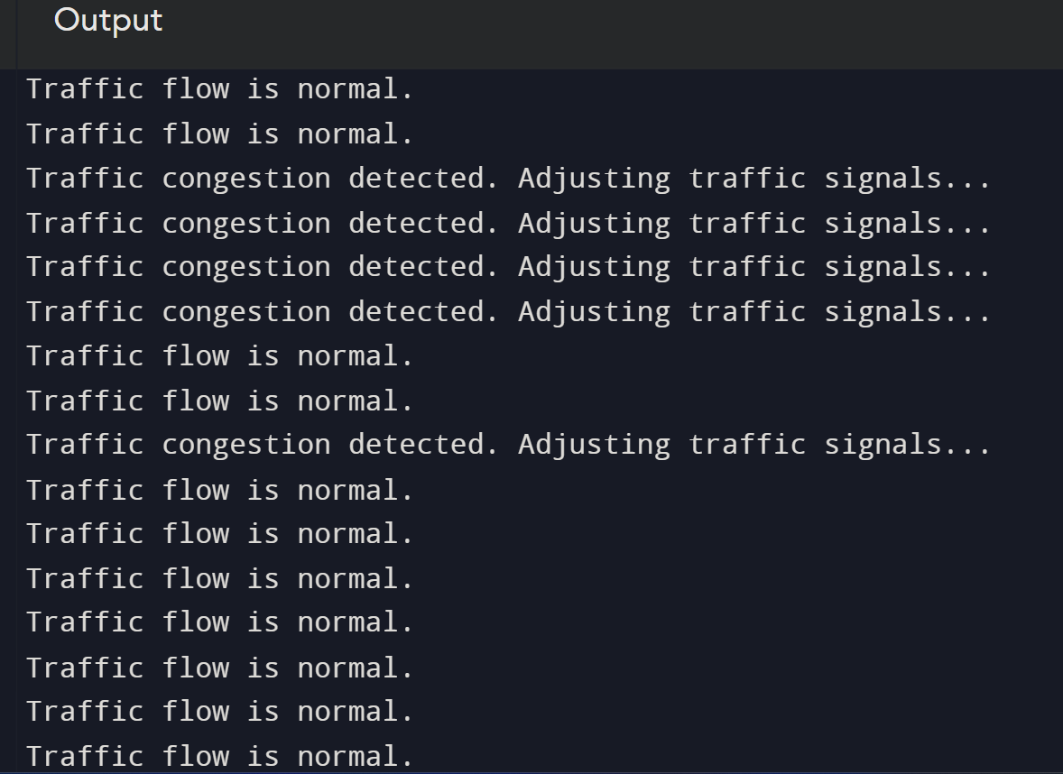
OUTPUT:

Slide 12
METHODS EXPLANATION
Data Collection: The first step in a cloud-based traffic management system is the collection of real-time traffic data from various sources
Data Transmission: Once the data is collected, it is transmitted to the cloud for processing and analysis
Data Processing and Analysis: In the cloud, the traffic data is processed and analyzed using advanced algorithms and machine learning techniques.
Traffic Management Strategies: Based on the analysis, the system can implement various traffic management strategies
Feedback Loop: The system continuously monitors traffic conditions and adjusts its strategies accordingly.

Slide 13
RESULTS AND DISCUSSION
Performance Metrics: Discuss the performance metrics used to evaluate the effectiveness of the cloud-based smart traffic management system.
Case Studies: Present case studies or examples of cities or regions that have implemented cloud-based smart traffic management systems
Comparison with Traditional Systems: Compare the performance of cloud-based smart traffic management systems with traditional traffic management systems
User Feedback: Discuss any feedback or user experiences with the system, including any challenges faced during implementation and operation
Future Directions: Explore future directions for research and development in the field of cloud-based smart traffic management systems

Slide 14
CONCLUSION
In conclusion, the adoption of a cloud-based smart traffic management system holds immense promise for revolutionizing urban transportation.
By harnessing advanced technologies like cloud computing, the Internet of Things (IoT), and artificial intelligence (AI), these systems can efficiently collect, process
Analyze real-time traffic data to optimize traffic flow and enhance transportation management strategies. The benefits are manifold: improved traffic flow
Reduced congestion, enhanced safety through quicker incident response, and environmental sustainability with lower emissions and fuel consumption. Moreover, cost savings are realized both by individuals
Municipalities through reduced fuel costs and optimized infrastructure utilization. Despite these advantages, challenges such as data privacy and security

Slide 15
REFERENCES
Dhingra, Swati, et al. "Internet of things-based fog and cloud computing technology for smart traffic monitoring." Internet of Things 14 (2021): 100175.
Gaouar, N., Lehsaini, M., & Nebbou, T. (2023). CCITL: A cloud‐based smart traffic management protocol using intelligent traffic light system in VANETs.
Javaid, Sabeen, et al. "Smart traffic management system using Internet of Things." 2018 20th international conference on advanced communication technology (ICACT). IEEE, 2018.
Rahimi, M. M., and F. Hakimpour. "Towards a cloud based smart traffic management framework." The International Archives of the Photogrammetry, Remote Sensing and Spatial Information Sciences 42 (2017): 447-453.

